Slide 1
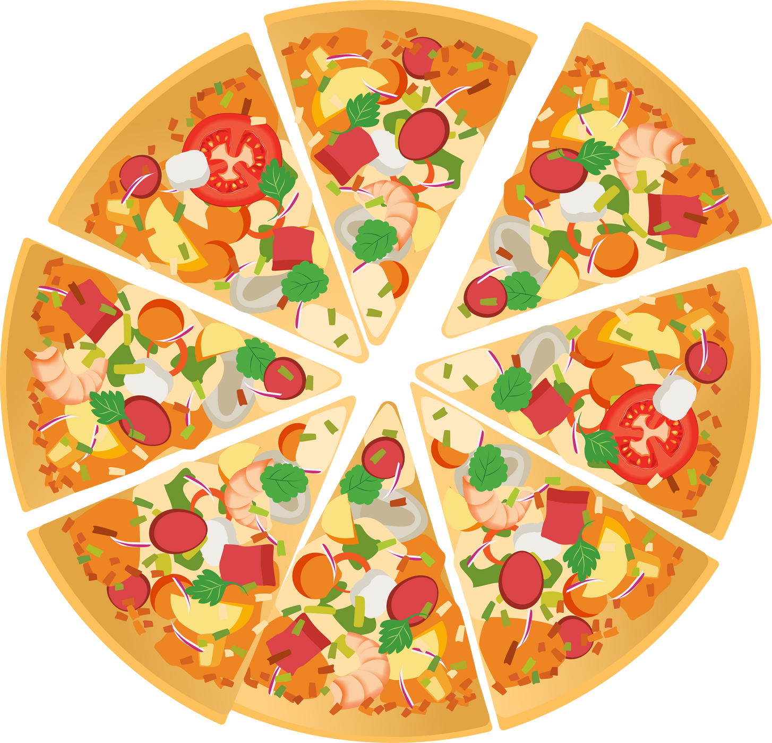


Grade 4 : Visualizing Fractions Annex 1
Pizza
Fractions
SEN Power project 2022-1-BG01-KA220-SCH-00085065

Slide 2



Question #1
You are sharing a whole pizza with a friend. How do you slice the pizza so everyone gets an equal serving?

Slide 3


Question #2
You are at a party with 3 other people. How is the pizza slice so everyone has the same size slice?

Slide 4
Question #3
If I wanted to share a pizza with two friends, how would I slice the pizza so everyone has an equal share?

Slide 5

Question #4
There is a partywith six people. How should be pizza be sliced so everyone has an equal share?

Slide 6
Question #5
If I slice a pizza into two equal pieces, I am slicing the pizza into ________.
halves
thirds

Slide 7
Question #6
If I slice a pizza into five equal pieces, I am slicing the pizza into ________.
fourths
fifths

Slide 8
Question #7
A man ordered a pizza and wanted it in four equal pieces. He wanted the pizza in ________.
fourths
fours

Slide 9
Question #8
I am sharing a pizza with five friends. I want the pizza sliced into ________.
fifths
sixths

Slide 10
Great Job!

